Slide 1
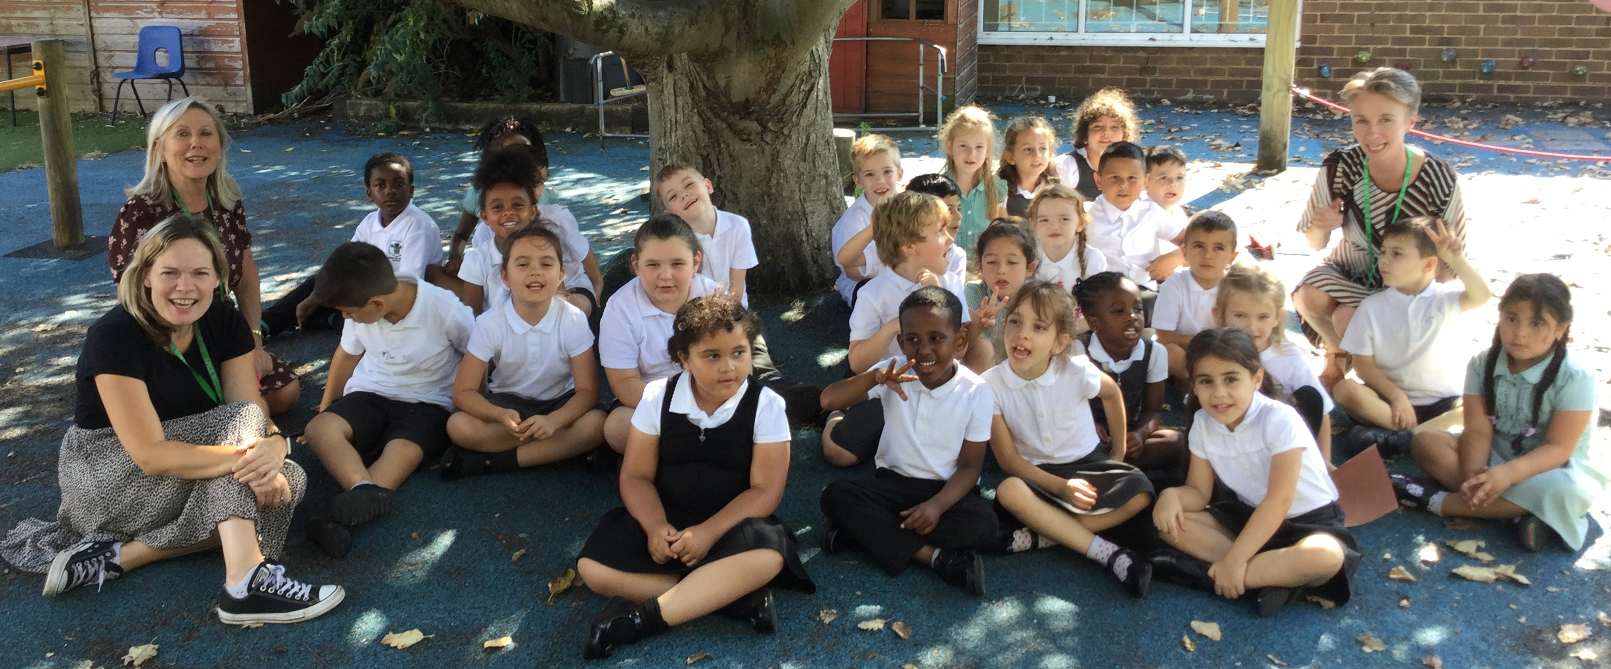
A Warm Welcome to Year 1
2021-2022
Learning Together, Growing Together

Slide 2
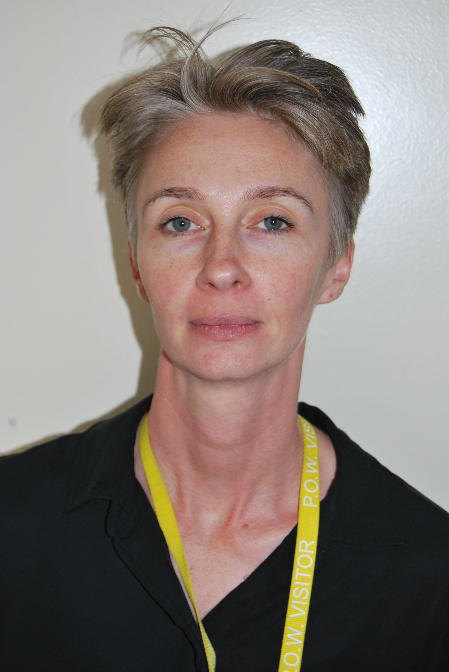
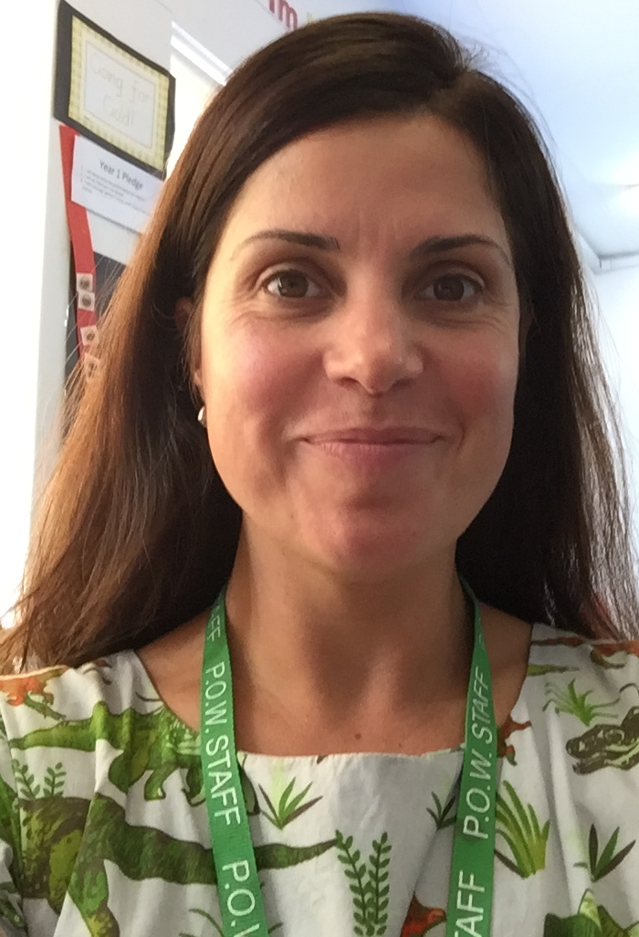
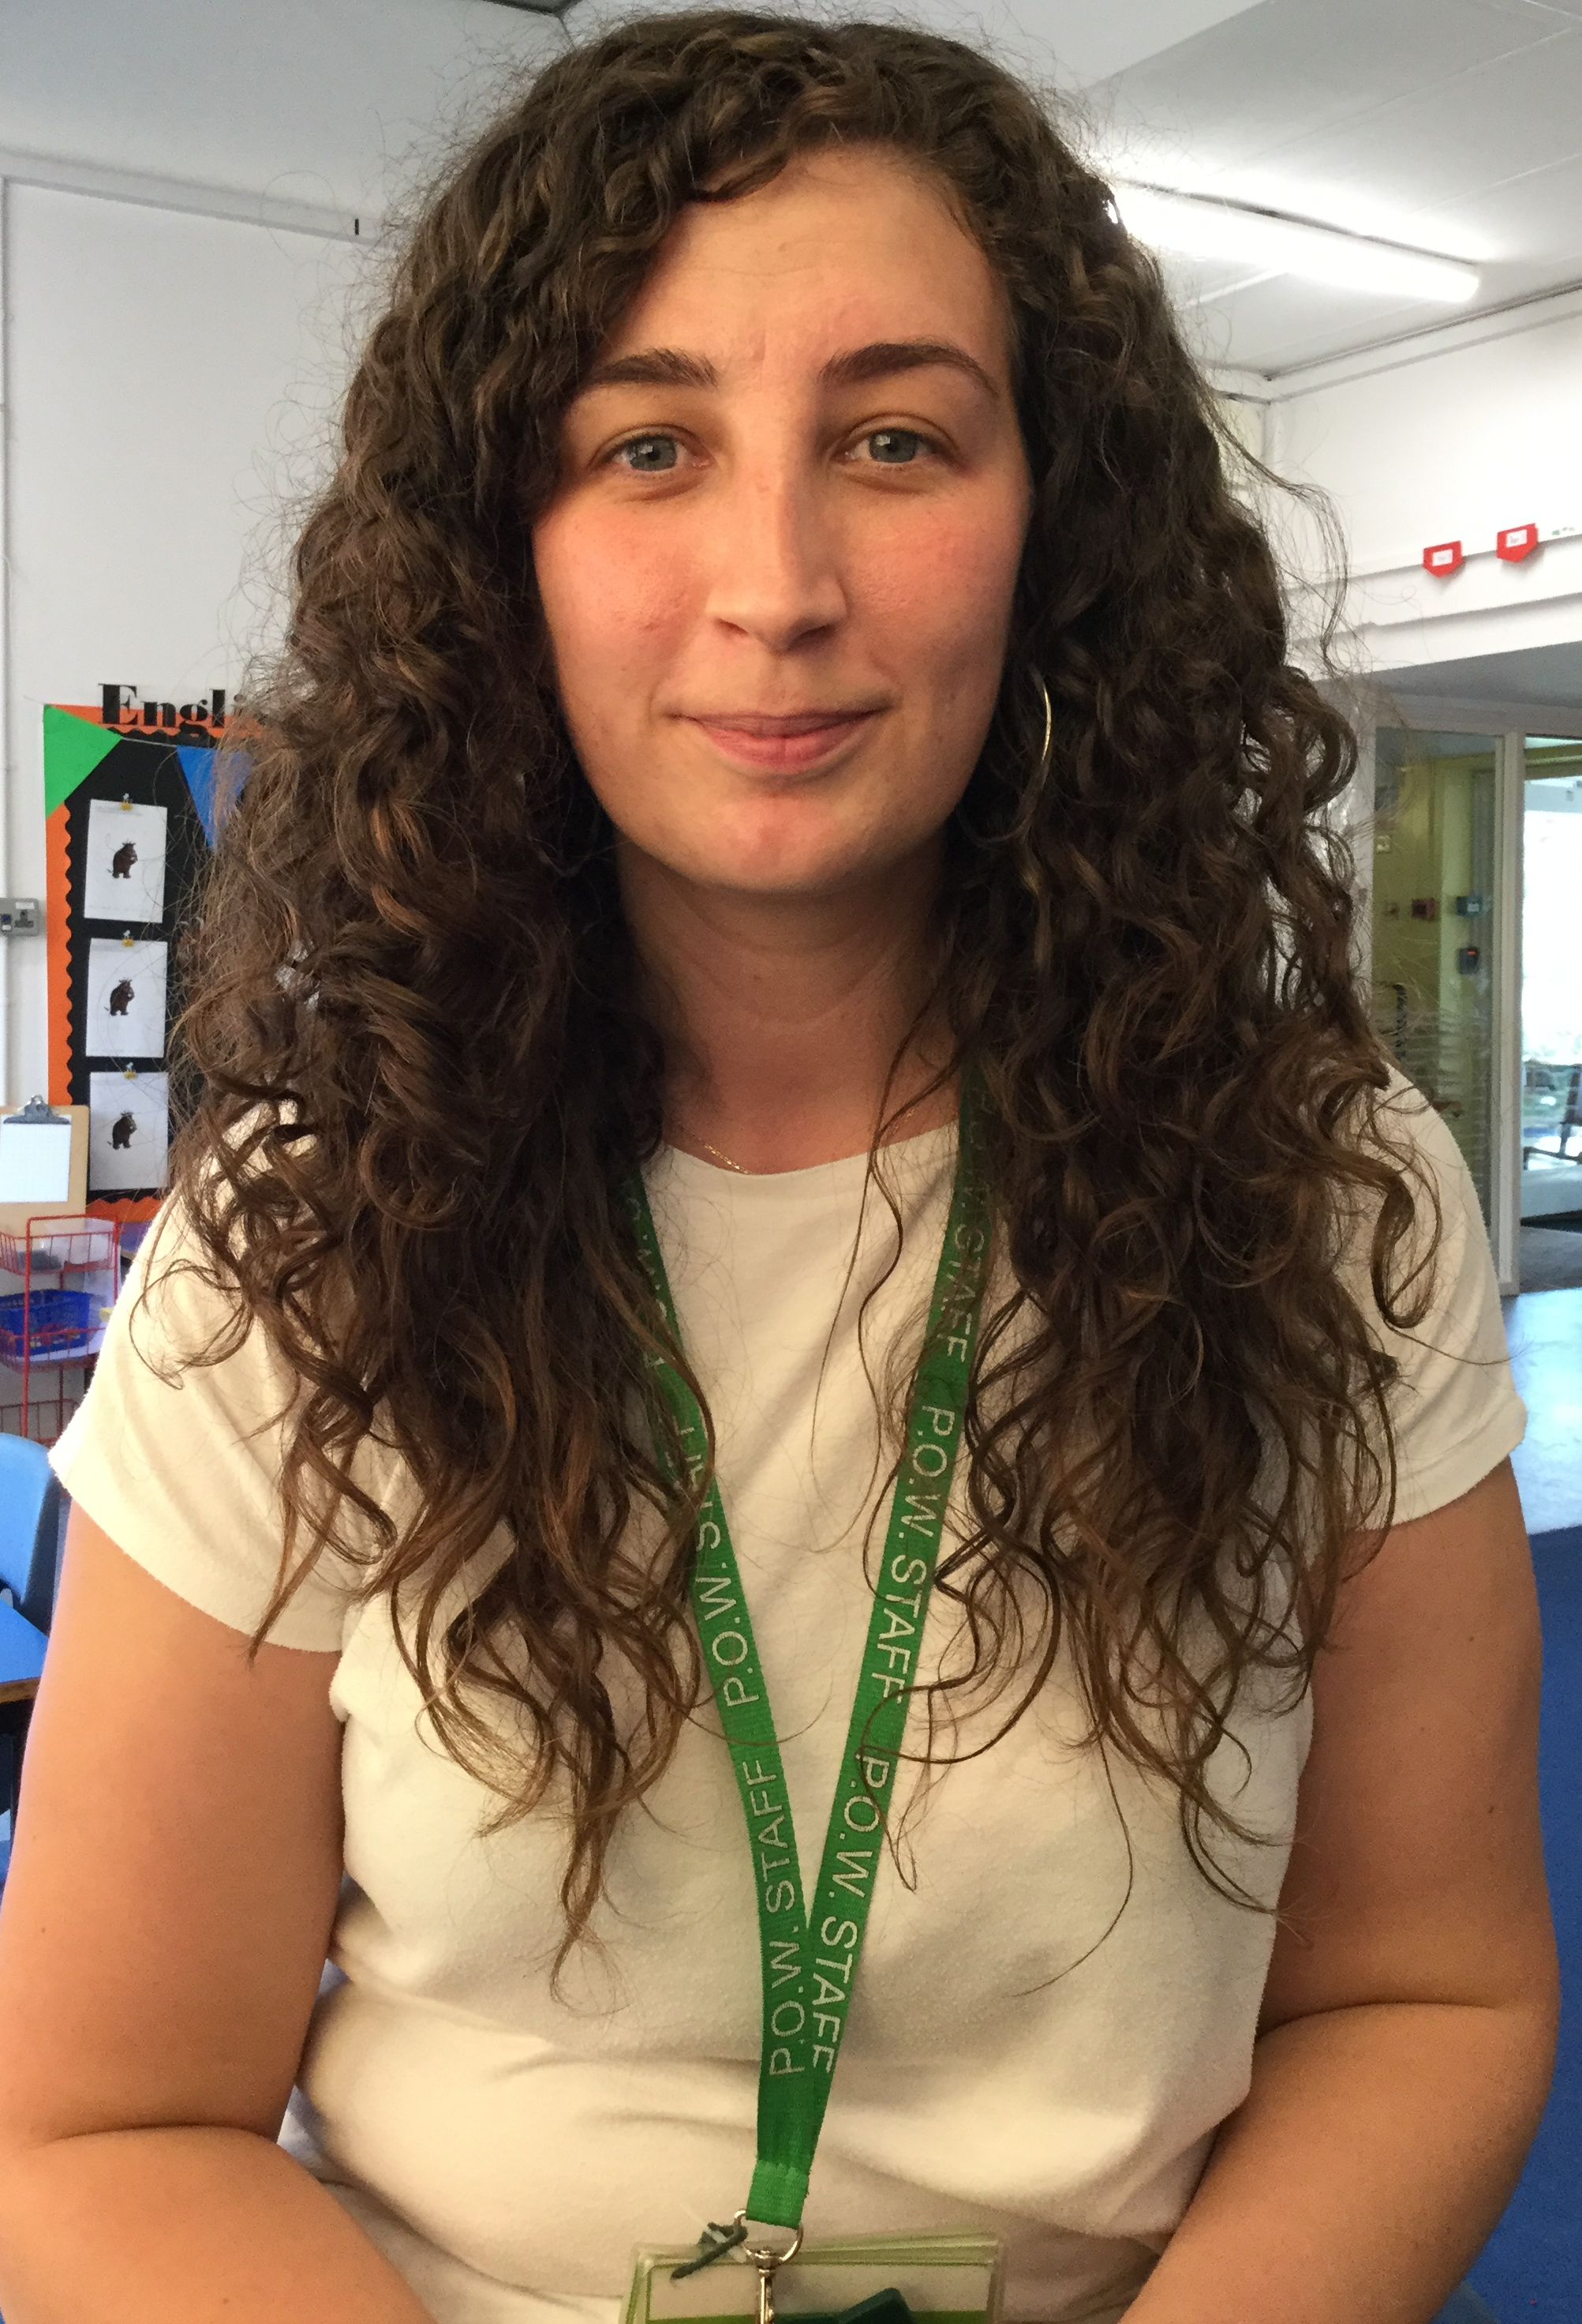
Year 1 Staff
Class teachers
Learning Support Assistants
Mrs Whyte, Mr Halley, Mrs Kancheva, and Mrs Kurt
Mrs Jones, Mrs Botterill, Ms Field, Ms Ruskin and Mrs Teke

Slide 3
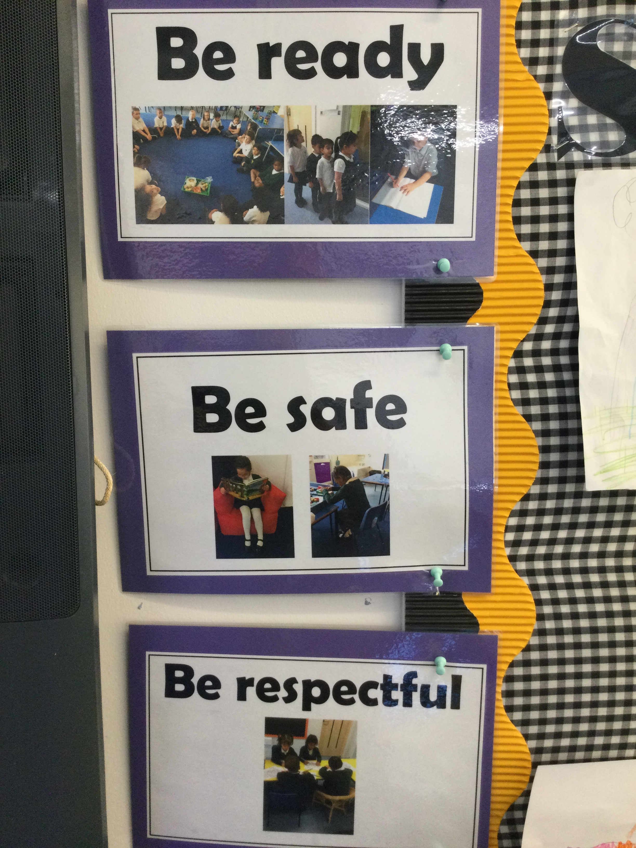
3 School Rules Be Ready Be Respectful Be Safe

Slide 4
Be Ready
Punctuality
School starts promptly at 8.40am and finishes at 3.20pm.
Children line up in the playground.
Attendance
It is important that your child does not miss any teaching days as this seriously affects their learning and opportunities
Book lunches in advance parents/carers select the school lunches at home. If you are unsure how to do it, please contact the school office for help in setting this up.
https://www.princeofwales.enfield.sch.uk/our-school/school-lunches/
Online-Menu-Choice-Selection.pdf (princeofwales.enfield.sch.uk)

Slide 5
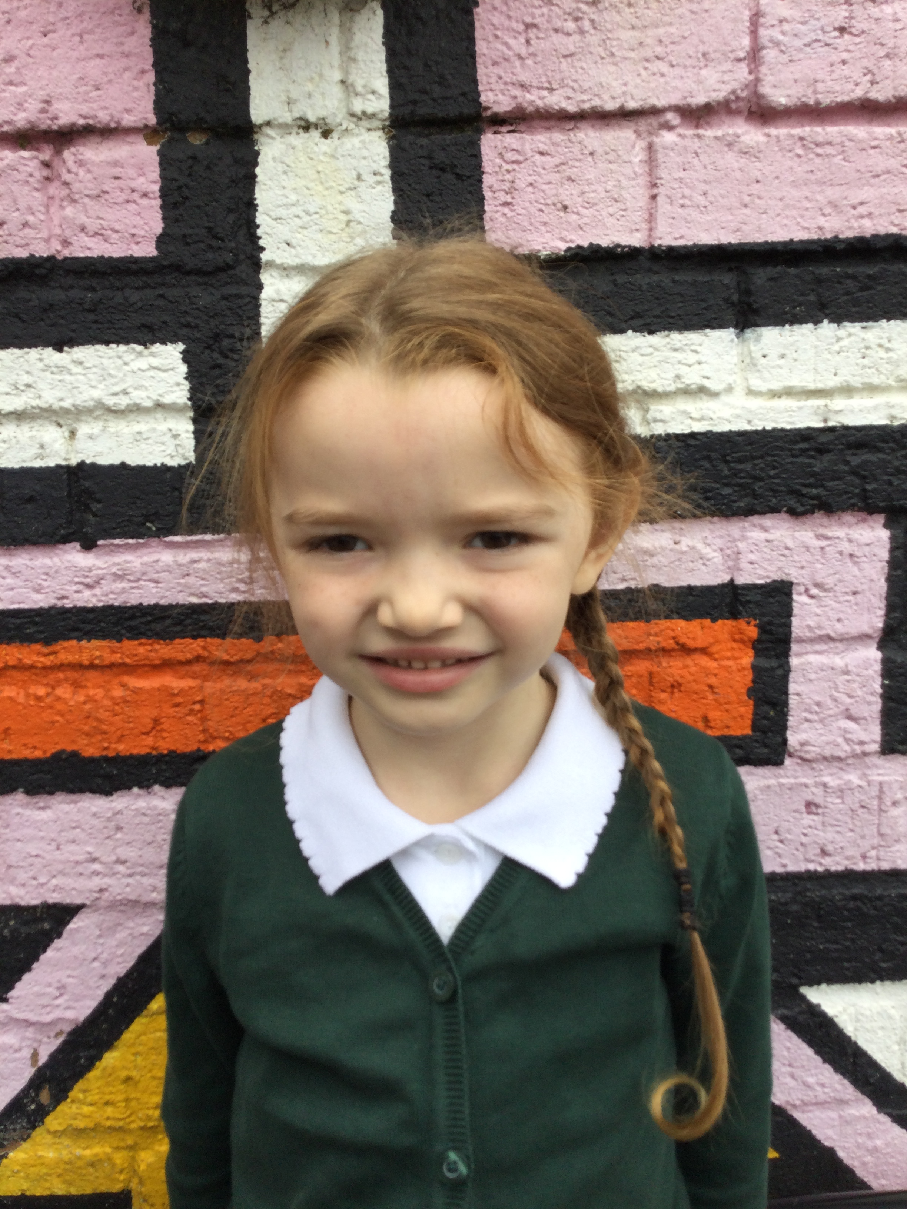
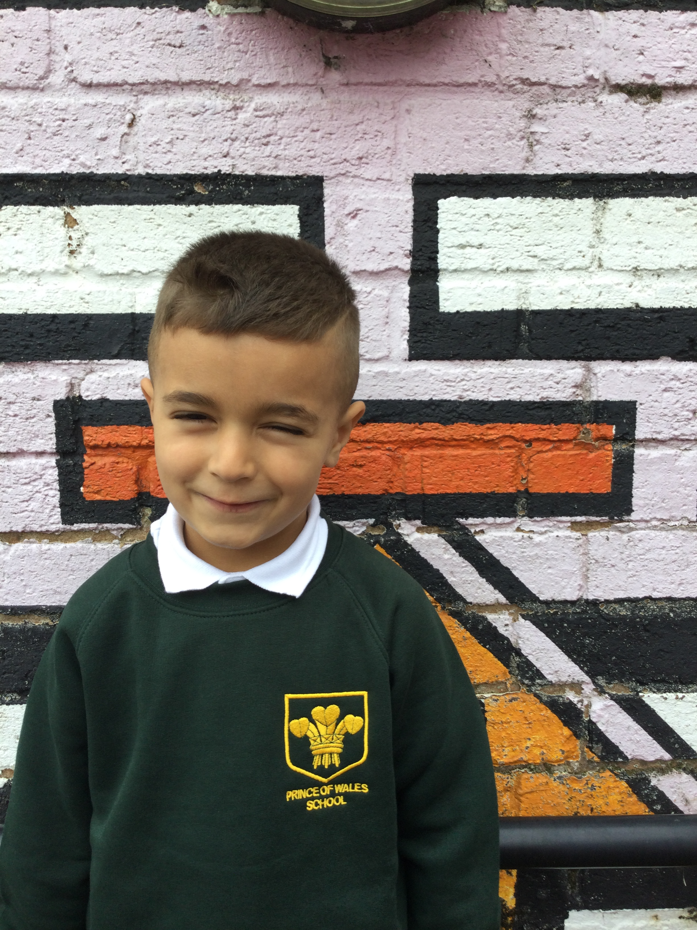
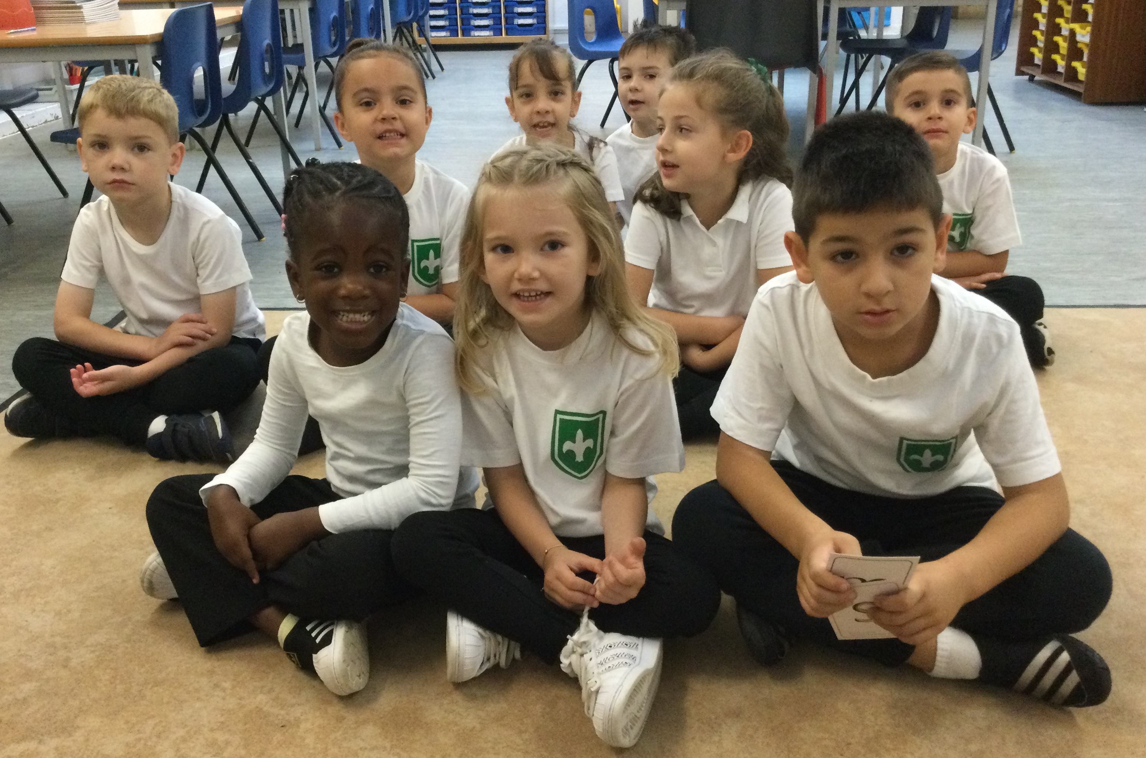
Be Ready
Uniform
Children should come to school in full school uniform
Grey skirt or trousers and no leggings
Plain black shoes with black soles
Plimsolls for indoor PE and trainers for outdoor PE
Black or green hair bands
No jewellery. Only small ear studs allowed
PE kit (white/black shorts and white t-shirt)
Friday PE Kit
Appropriate hair styles
No nail varnish

Slide 6
Be Ready
Homework
We have a flexible approach. We encourage all children to use Teams but homework books can be provided.
In addition to set homework there is an expectation that
Children read everyday and have their reading record signed and brought to school every day
https://www.phonicsplay.co.uk/resources/phase/4

Slide 7
Be Respectful
Working Together
The partnership between child, parents and school is crucial to your child’s success. Keep yourself informed through
-school website
-newsletter and communication via email
-accessing parent consultations, Cafés and other events
If there are any concerns about learning please contact the class teacher in the first instance.

Slide 8
Be Safe
Medical needs - let Mrs Dunlea know
Bring in if slight cold
Change of details
Place2Be

Slide 9
Curriculum map
See website

Slide 10
Reading
£5 that will be charged for lost or damaged books.
Ms Thambia and Ms Lobosoco

Slide 11
Dates
World Harvest - 12 October
Beauty and the Beast Café – 12th October
Parent Consultation- October 18th
National Tree Day - 2 December
INSET 6th December

Slide 12
Week commencing Monday 6 June 2022 Phonics screening check week

Slide 13
Any questions?

