Slide 1
Exploring Numbers Session 2
With Miss Maths

Slide 2
Today’s online lesson will look at:
Solutions from yesterday’s challenge
Averages and the Range
Did you watch the video from yesterday?
https://www.bbc.co.uk/bitesize/topics/zm49q6f/articles/z99jpbk
Today’s number investigation will take place in
our online lesson.

Slide 3
.
The Three Neighbours Solution:
a+b+c= ?
2+3+4=9
5+6+7=18
10+11+12=33
35 + 36 + 37 = 108
If we replace each number with a letter we have a+b+c=
What can you tell me about the sum of these numbers?
Can you make a rule /spot a pattern in all of the examples?
What can you tell me about the relationship between a and the sum of all 3 numbers?
How can we show this algebraically?

Slide 4
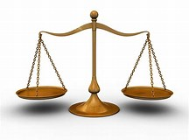
The solution algebraically
(3 x a) +3 = the sum of all 3 numbers
or
3a+3=a+b+c
Did you think about a solution for Four Neighbours?

Slide 5
Averages
An average is a typical amount
It helps you understand data
Q What is the average amount of pocket money for a year 6 child?
Q What was the average number of goals scored by the Prince of Wales football team this year?
What was the average temperature in May?
Make up 2 of your own questions.

Slide 6
There are 3 main types of averages:
The mean
( I call this this the ‘mean one’ because it needs the most working out compared to the others)
Let’s learn about averages by using spelling test scores.
1-Add up all the scores that the children got in their test.
9+10+4+9+8=40
2-Divide the total by the number of children
40÷5=8
So the mean average is 8
The average mean spelling test score was 8 marks

Slide 7
The median
(medium size, the middle size)
Look a those spelling scores again.
1-Order the numbers.
2-Now find the middle number.
4,8,9,9,10
The median score is 9
(If there were 2 numbers in the middle add them together and then half that number,
That’s the median!)

Slide 8
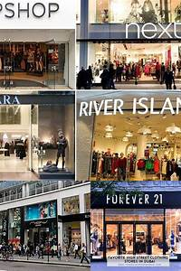
The mode
In Greek Moda = fashion
When I think of a fashion trend I think
of clothing that appears the most in the high street.
Look the spelling scores, what appears the most?
4,8,9,9,10
The median score is 9

Slide 9
Work out the mean, median and the mode and the range for these sets of numbers:
A) 2, 3, 5, 9, 14, 9, 6
B) 10, 6, 11, 15, 25, 10, 5
C) 24, 30, 10, 16, 32, 10, 0, 25
d) 100, 200, 150, 125, 75, 200, 300
The range is the difference between the largest and the smallest numbers in a set.
The range is useful in sports, e.g look at the range of goals scored by a team in a month and then compare it to the range of another team.

Slide 10
Before we begin let’s look at the skills you will develop:
Independent thinking
Q What do I have to do?
Q How do I go about this?
Arithmetic skills
Q Will I use a formal method or a mental calculation?
Exploring numbers (‘playing around with them’)
Making observations, spotting patterns
Making a rule and proving it
Creative thinking
Resilience
Communicating ideas

