Slide 1
Challenges

Slide 2
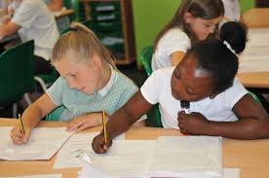
What is ‘challenge’?

Slide 3
From the pictures, you can see that challenge takes many different forms. It could be…..
Trying something for the first time
Completing a task which we don’t find easy
Competing against others or yourself
Taking part in a task that tests your abilities and skills

Slide 4
Have a think… Have you had challenges recently?
What Challenges have you faced?
How did they make your feel?

Slide 5
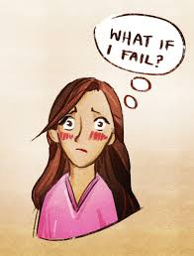
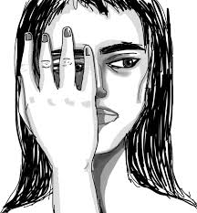
Challenges can sometimes make us feel
Competitive
Self-doubt
Anger and frustration
Confused
Disappointment

Slide 6
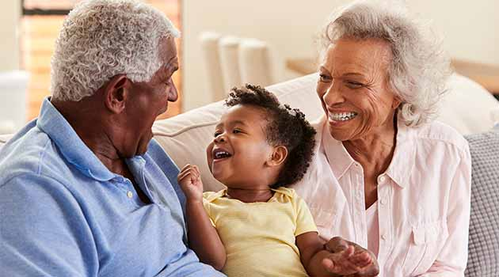
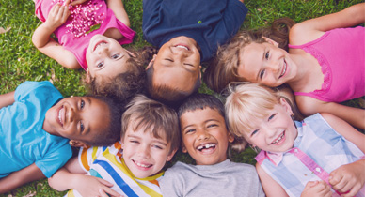
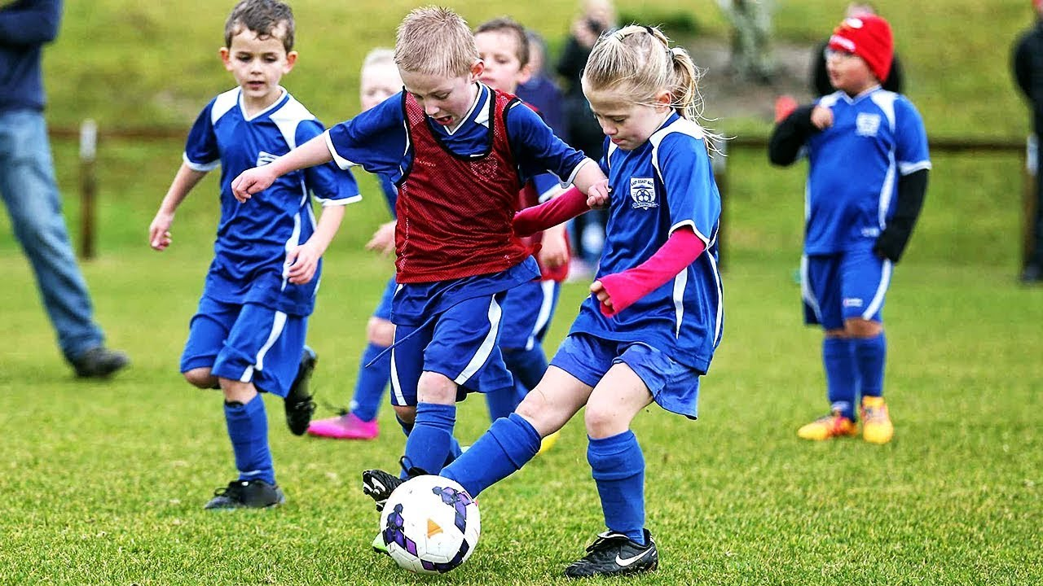
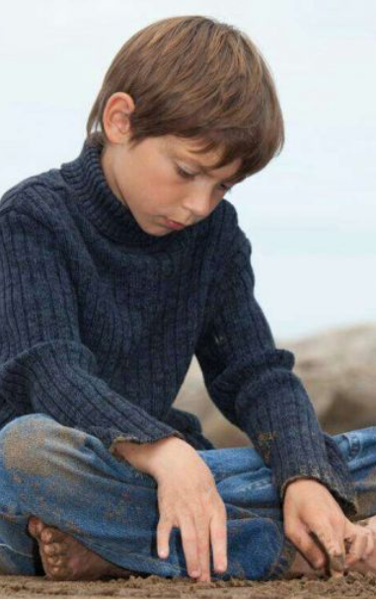
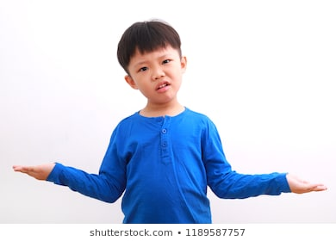
What challenges might you be facing right now?
Missing family that you don’t live with.
Missing your friends.
Not being able to do your favourite activities.
Finding your school work difficult at home.
Feeling bored and lonely.

Slide 7
Have a think about what you could do to make these challenges easier to deal with.

Slide 8
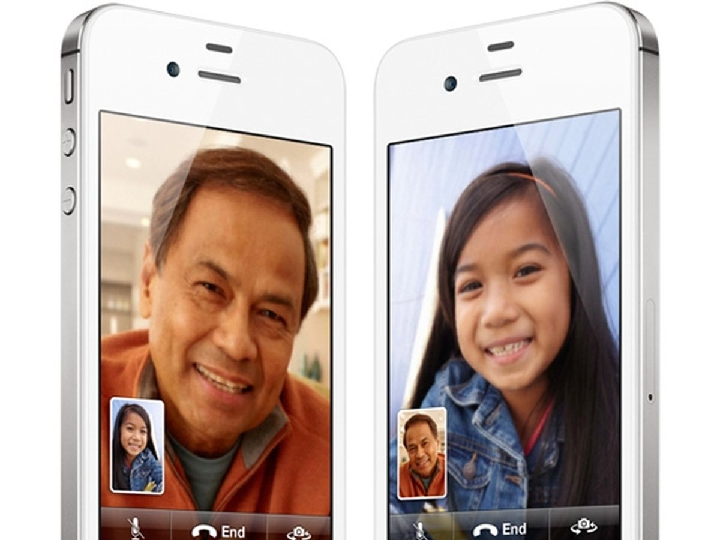
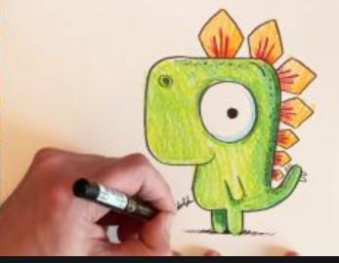
Missing family that you don’t live with.
You could:
Facetime or call them
Draw each other pictures
Send photos
or videos
Write letters or send messages.

Slide 9
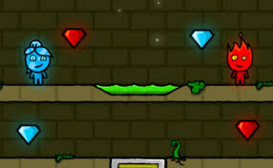
Missing your friends
You could:
Ask your parents if you can call them.
Ask your parents to help set up 2 player games.
Send messages or emails with your parents permission.

Slide 10
Not being able to do your favourite activities.
There are some activities that you might not be able to do at all, like swimming, but for others there are still many ways you can enjoy your hobbies.
You could:
Look on YouTube, many people are creating videos that show you how to adapt your hobbies so you can enjoy them from home.
Make good use of your local parks, whilst following social distancing guidelines.
Make the most of your space at home, try to find ways to do your favourite activities where you can.

Slide 11
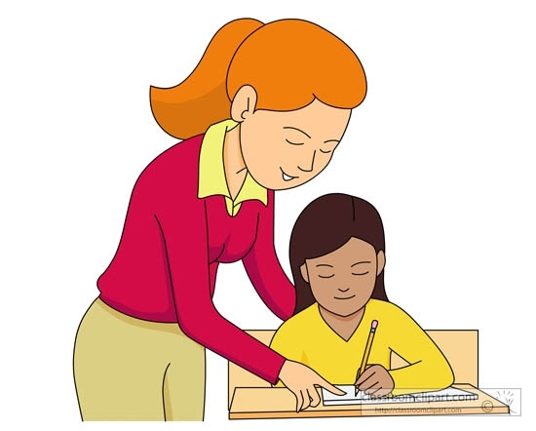
Finding your school work difficult at home.
Your parents are doing the best they can to help you with your school work, but it can be harder to concentrate at home. You also may not have access to the resources you are used to using to support your learning.
Remember! Your teachers are eager to
support your home learning. You can contact
them during the day to ask any questions about your learning and they will respond as soon as they can.

Slide 12
Feeling bored and lonely
Everyone feels a little strange right now. This pandemic has changed our day to day lives and many of us are missing lots of different people and lots of the activities we used to enjoy regularly.
Don’t be shy to express your feelings to people close to you. They are probably feeling the same and talking will help you feel together.
You could talk to:
Your family
Your friends
Your teacher

Slide 13
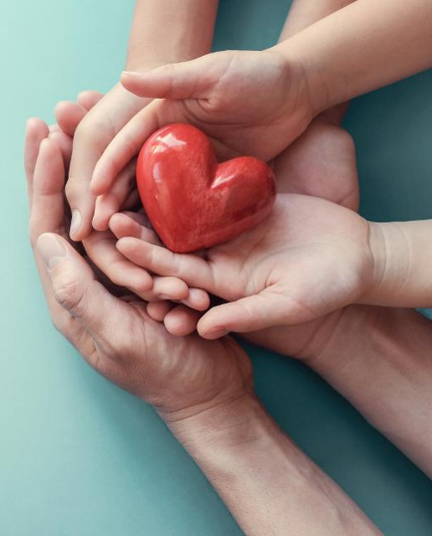
Challenges!
Challenges are an important part of life. They help us to learn and grow and we often look back at things we found challenging before but now find easier.
Hopefully this pandemic will help us to become more:
united
independent
compassionate

