Slide 2
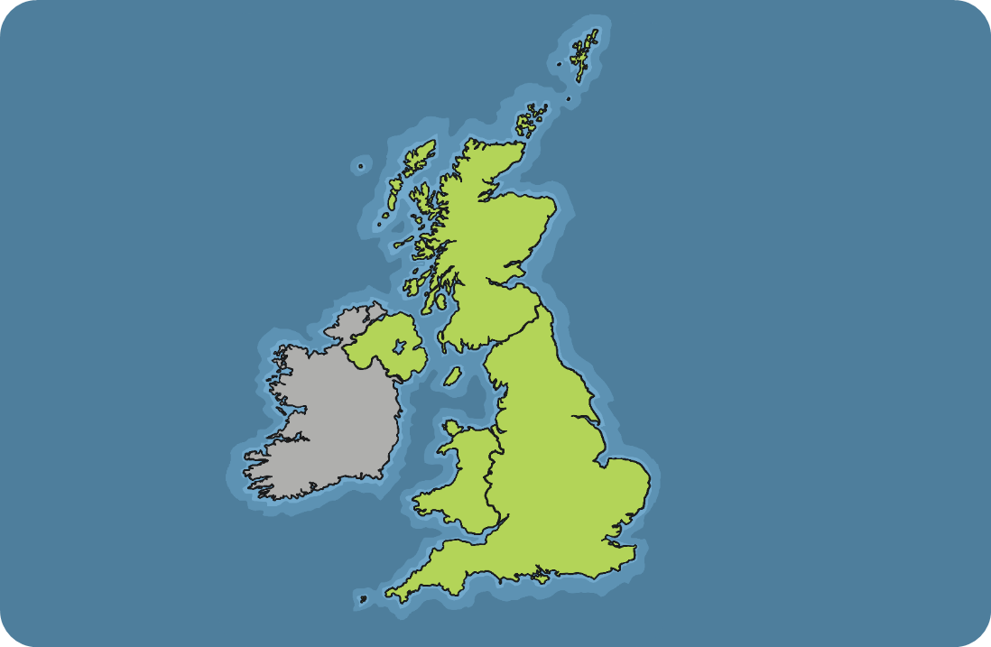
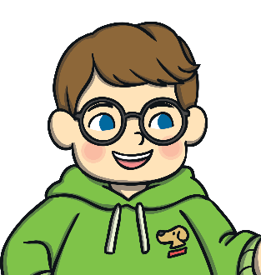
Where We Live
Have a look at the map below.
This is the United Kingdom (UK).
Can you find where you live on the map?

Slide 3
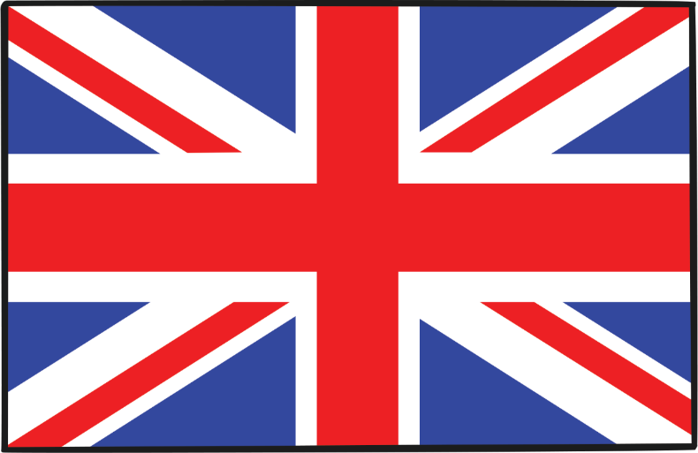
Union Jack
This is the flag that represents the countries of the UK –
England, Scotland, Wales and Northern Ireland.
It is called the Union Jack or Union Flag.
What colours and patterns can you see?

Slide 4
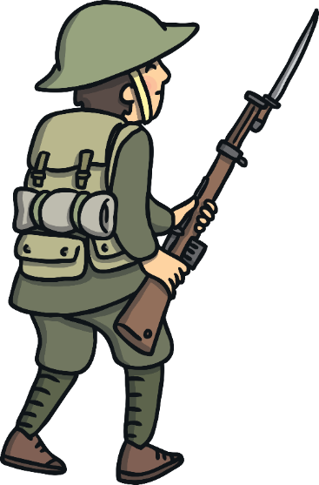
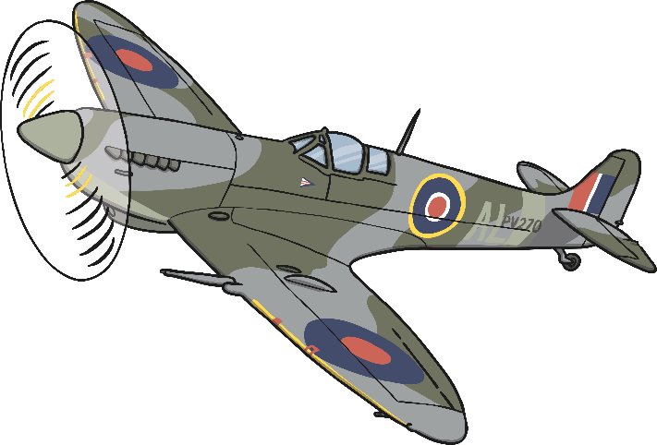
Second World War
Between the years of 1939 and 1945, the UK and other countries around the world were at war. This was a very difficult time. Soldiers had to go and fight for their country.

Slide 5
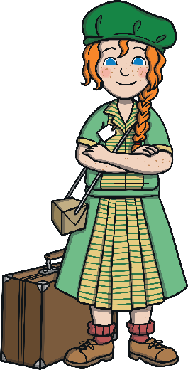
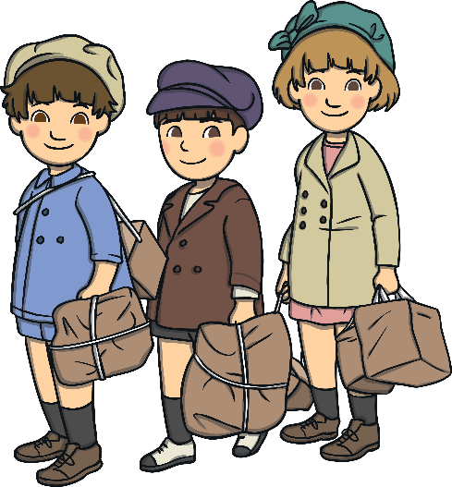
Second World War
As well as soldiers going to fight, some children had
to move out of big cities to stay safe and food was
rationed to make sure that everyone had enough to eat.
How do you think people felt during the war?

Slide 6
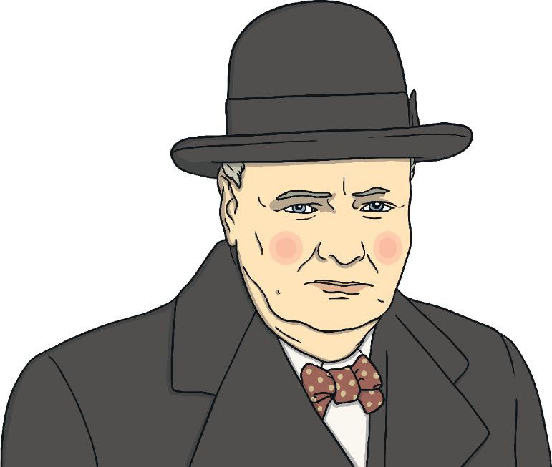
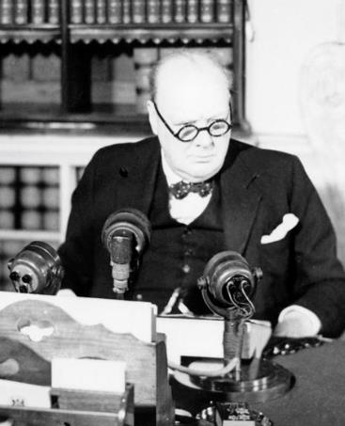
8th May 1945
On the 8th May 1945, Winston Churchill, the Prime Minister, announced to the UK that the war was over.
Winston Churchill announcing the
war is over on the radio.
How do you think people felt when Winston Churchill announced the war was over?

Slide 7
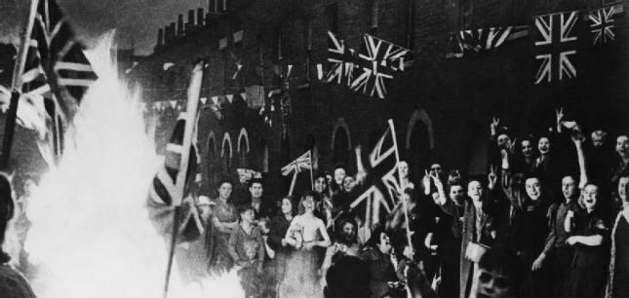
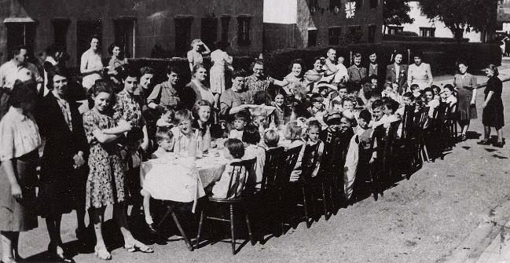
VE Day Celebrations
The 8th May 1945 became known as Victory in Europe Day, or VE Day for short.
People went out in their streets to have a party and celebrated the war being over. They waved Union Jacks, put up bunting, danced and shared food with each other.
Why do you think people wanted to celebrate?
What can you see in the pictures?

Slide 8
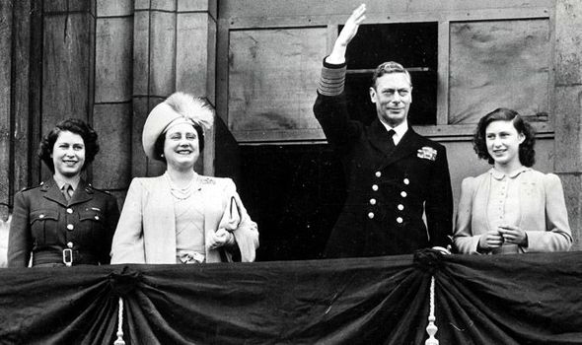
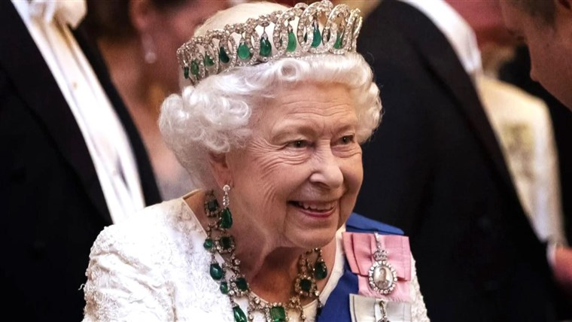
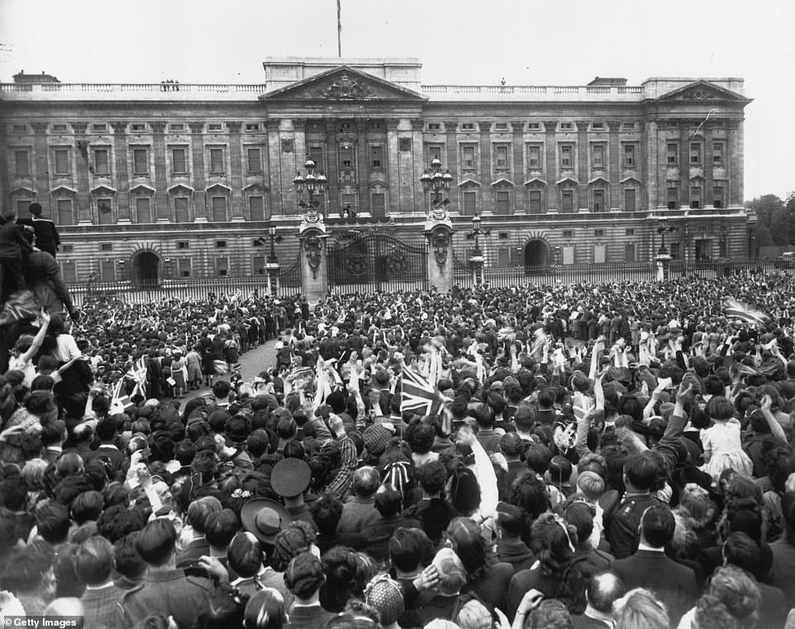
Queen Elizabeth II
Here is Queen Elizabeth II greeting the crowds at Buckingham palace for VE day. She was just a princess here and her Dad was King Geroge VI. She is there with her Mum and sister Princess Margaret.
She broke Royal rules and went in to the crowds to celebrate VE day, that’s how happy they were!
This is what Queen Elizabeth II looks like now.
Why does she look different here?
Why do the photos look different?

Slide 9
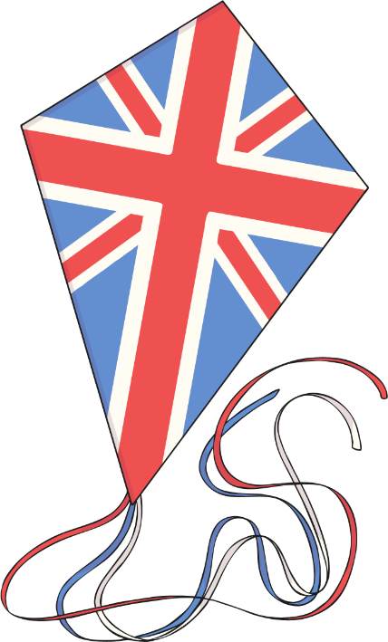
VE Day Celebrations
Every year on the 8th May, VE Day is celebrated around the UK and in Europe.
People celebrate VE Day in lots of different ways, such as having a picnic in their garden and singing songs to remember that important
day in 1945.
Friday 8th May 2020 is the 75th anniversary of VE Day.
Will you be doing anything to celebrate VE Day?

