Slide 1
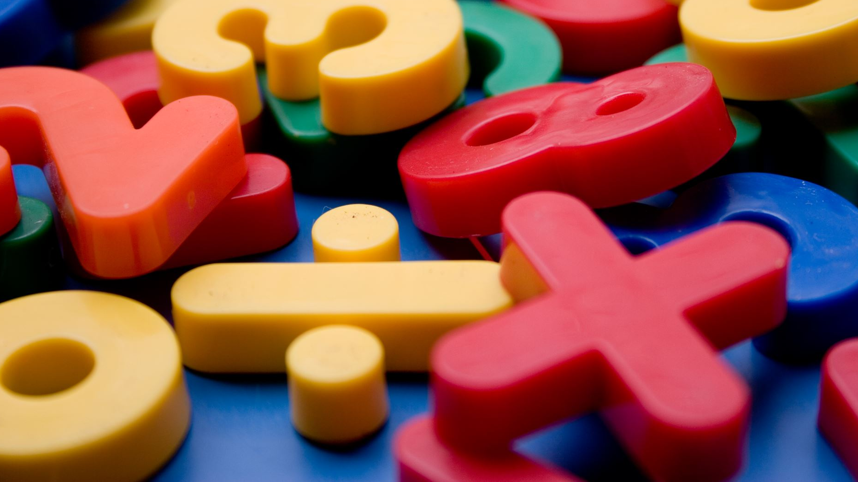
Year 6 Maths
with Miss Maths

Slide 2
Daily Maths with Miss Maths
Today we’re having our 2nd BODMAS lesson.
This is building on previous learning.
My group can join me at 11am or work through this power point at home.
My little tips and tricks are there to help you memorise your learning.
A useful video to watch:
https://www.bbc.co.uk/bitesize/topics/z69k7ty/articles/z24ctv4

Slide 3
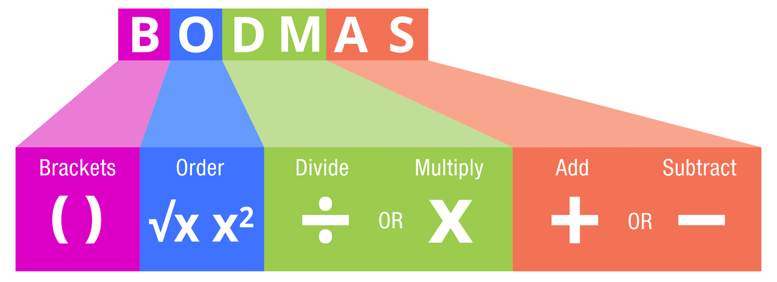
BODMAS Part 2
What is BODMAS?
Why do we need these rules?

Slide 4
A world without BODMAS…
10 + 30 ÷ 5 + 6 =?
10 + 30 ÷ 5 + 6 =?
Now do not use BODMAS to solve the same number sentence.
Start from the left and work towards the right.
What have you noticed about your answer?
Solve the number sentence above using BODMAS.
Remember to add those brackets around the most powerful operation…
BODMAS is a much needed set of rules in the maths world.

Slide 5
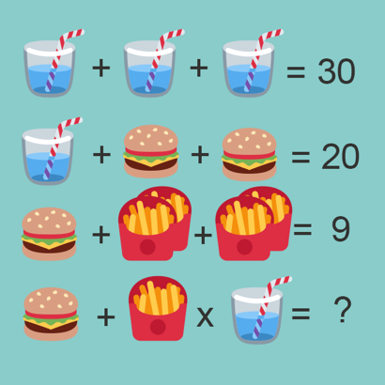
Here we have algebra (unknown amounts) and we have to follow BODMAS.
Usually mistakes with these types of puzzles are down to not knowing about BODMAS or not looking closely enough at the picture.
Can you solve the puzzle?
Start from the top line and work downwards.
There will be a line that will require your knowledge of BODMAS so put those brackets in.
There’s also a change in the number of objects…look closely!

Slide 6
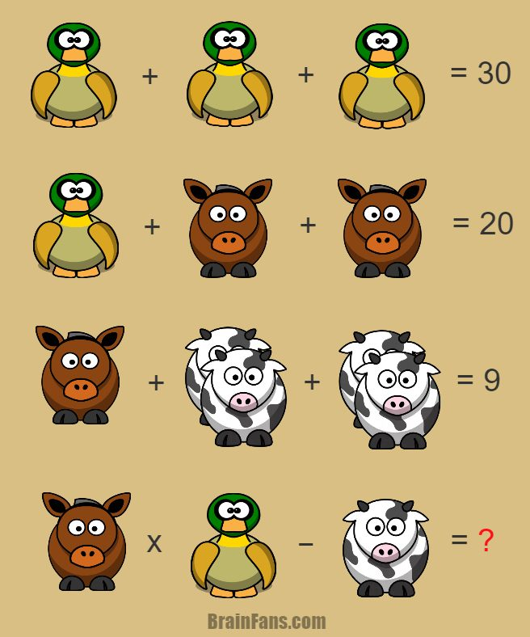
Look out for the number of animals and then BODMAS on the final line!

Slide 7
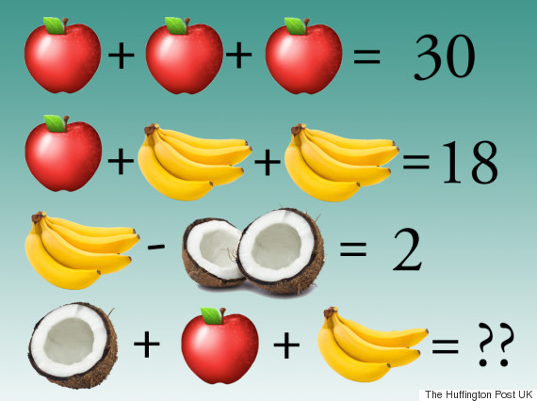
Look out for the number of fruit …

Slide 8
Look out for the number of objects and the BODMAS rule…

Slide 9
What should you look out for here?

Slide 10
Solve this: Follow BODMAS. Add 2 pairs of brackets to the priority parts. There should be a few lines of jottings. Challenge-Now change the sevens to a different number and solve.

Slide 11
A Home learning challenge
Make up your own Maths Puzzle similar to the picture challenges from today.
Make sure you include:
Pictures instead of numbers
4 number sentences, start off simple!
A number sentence where you have sneakily changed the number of objects.
A final line number sentence where BODMAS is needed to get the correct answer.
My favourite puzzles will go into the newsletters.
Email your puzzle and answer to your class teacher by Monday ☺

