Slide 1
[Menu]
Logging In
Notes:
This section is for when the children are in front of a device.

Slide 2
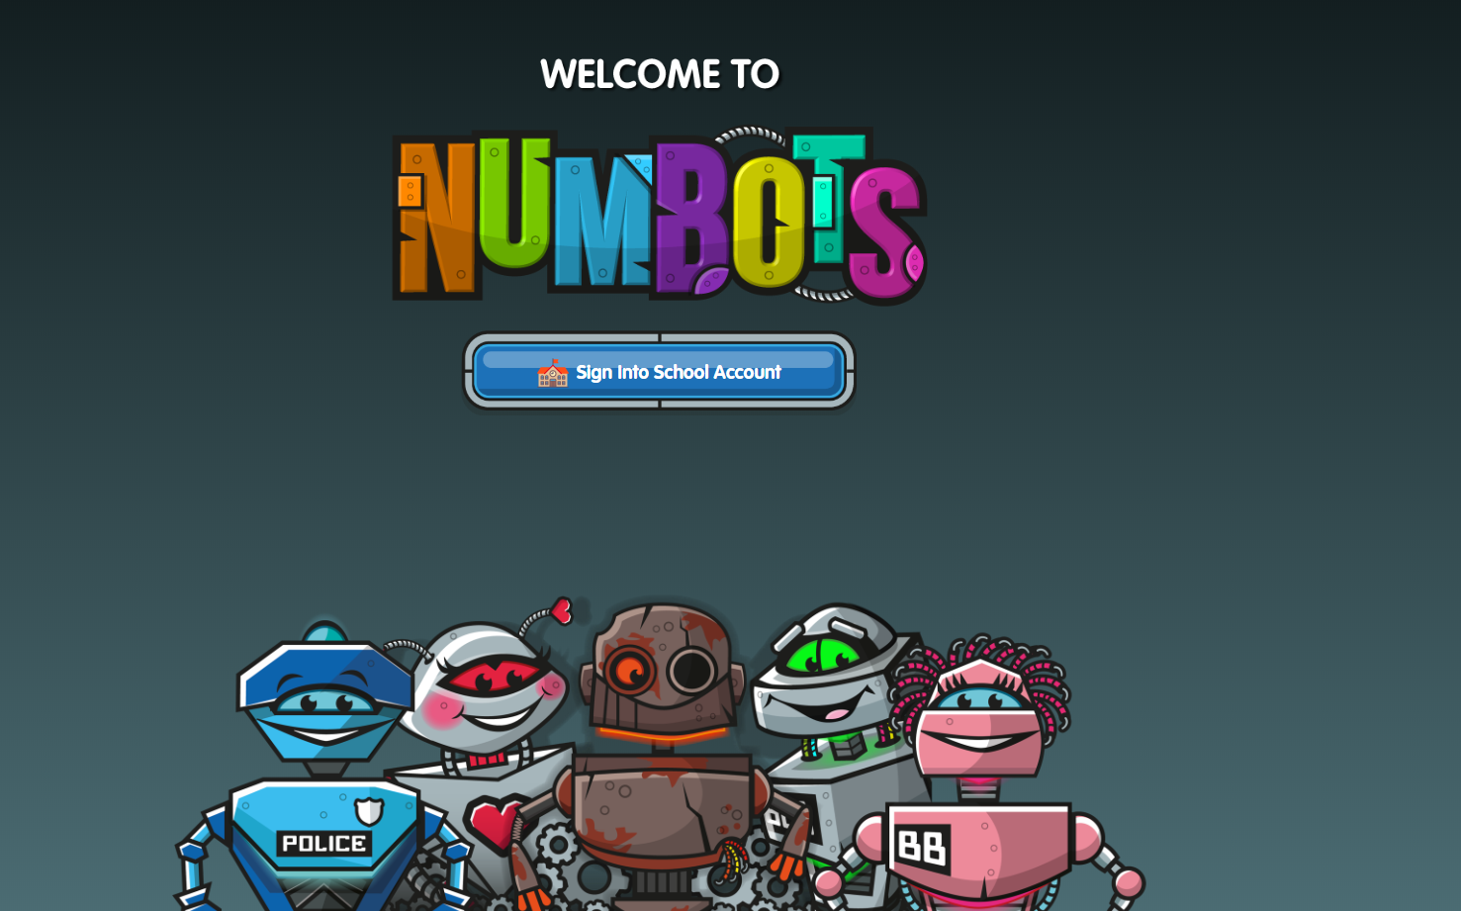
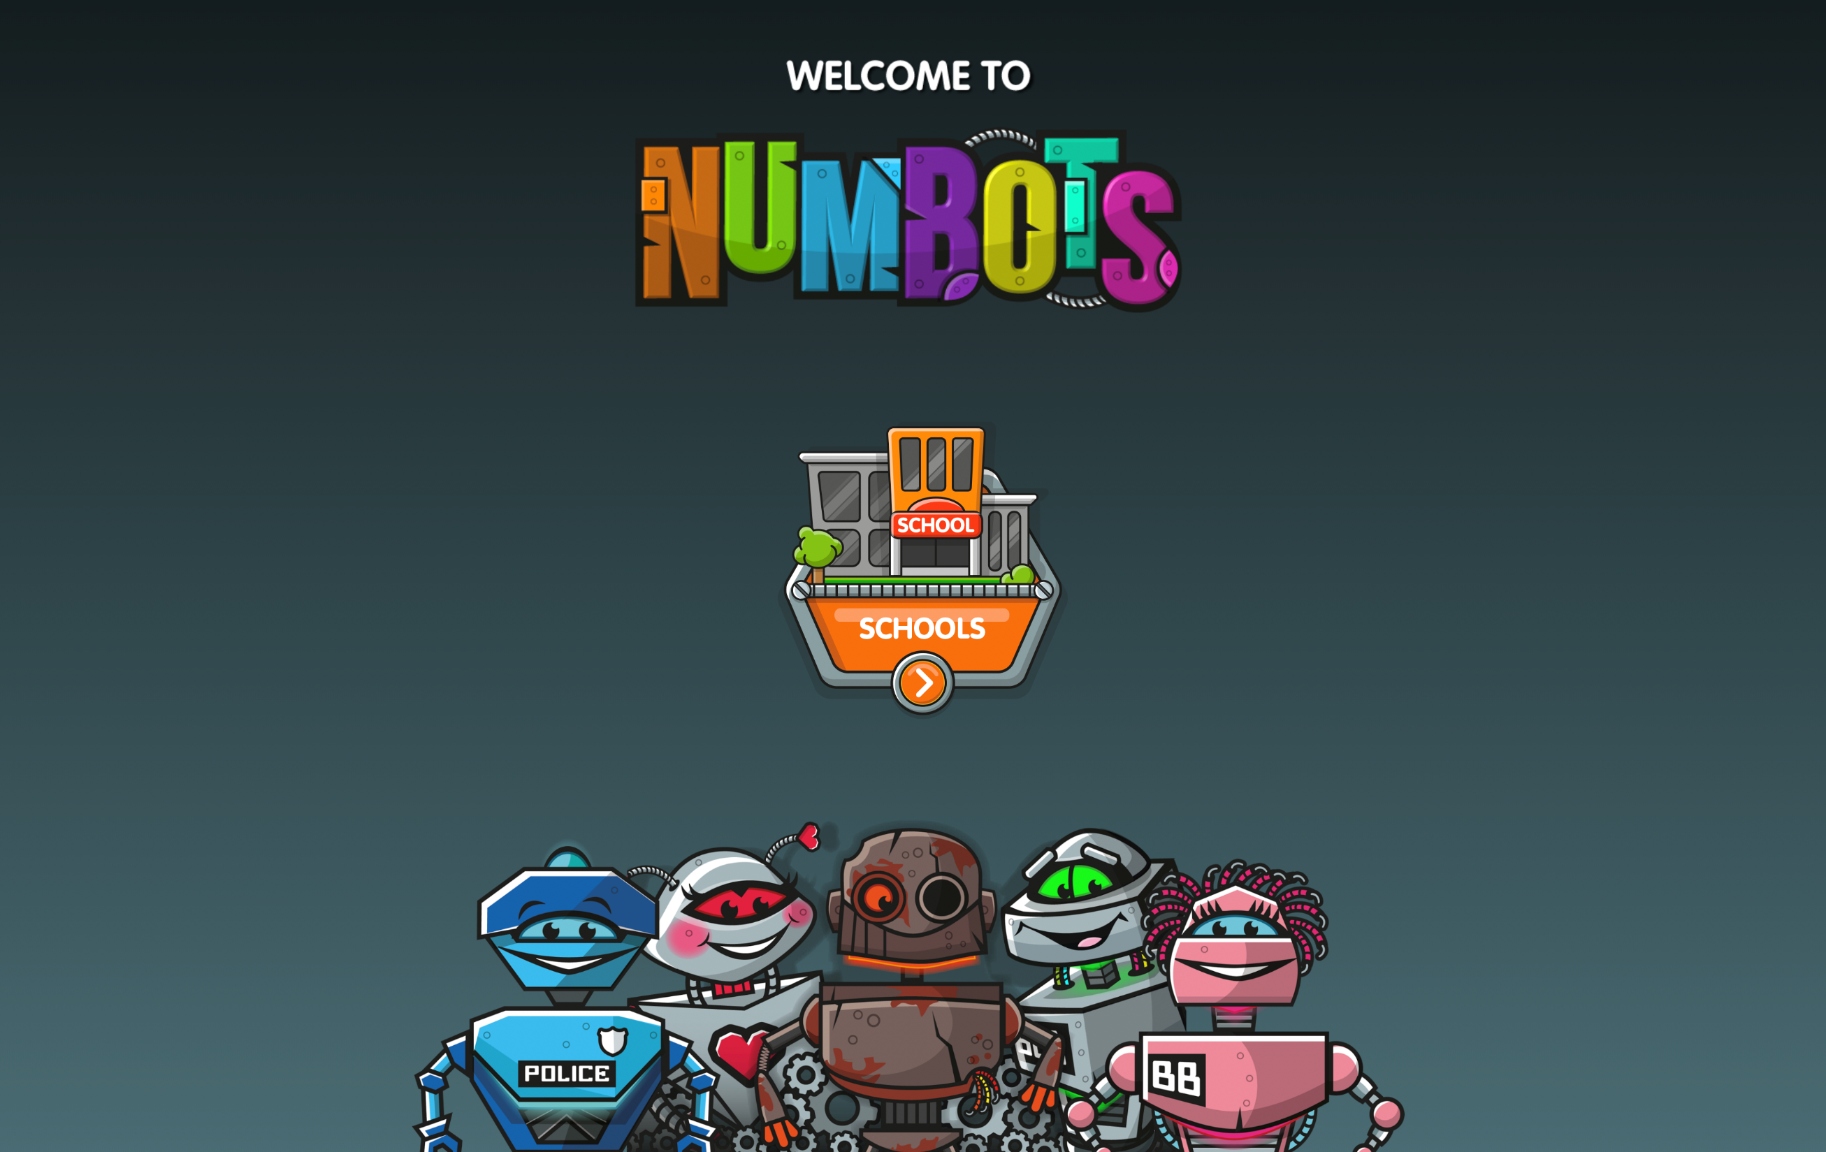
[Menu]
100

Slide 3
[Menu]

Slide 4
[Menu]
Type school name or postcode

Slide 5
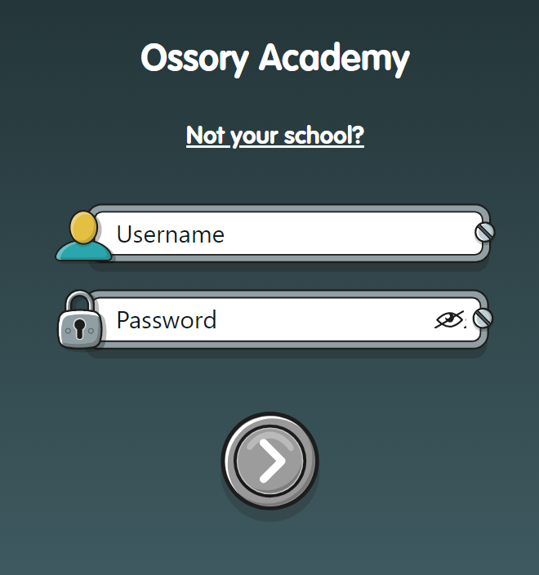
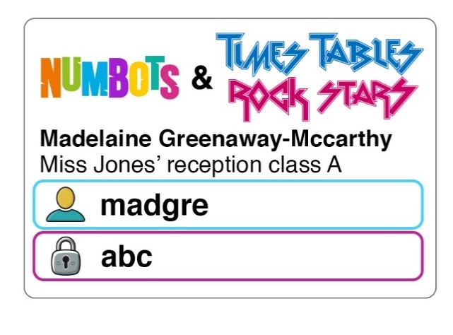
[Menu]
Example label
Logging In
madgre
abc
Your turn!

Slide 6
[Menu]
Prince Of Wales Primary School, Enfield

Slide 7
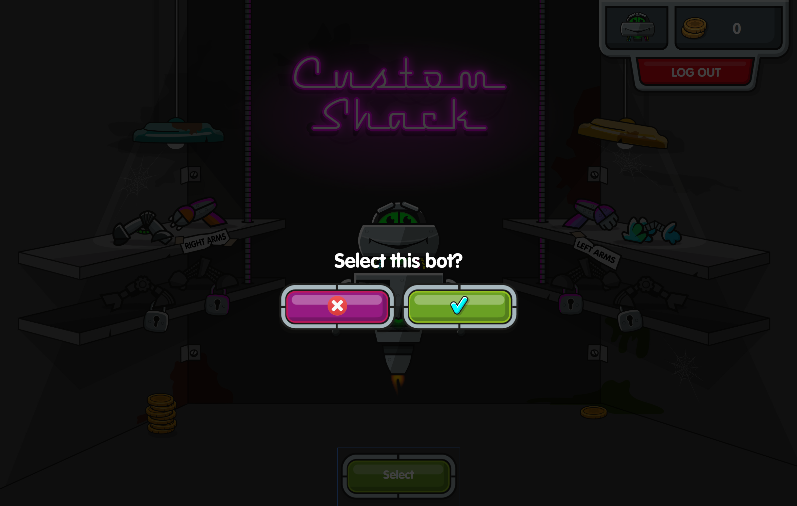
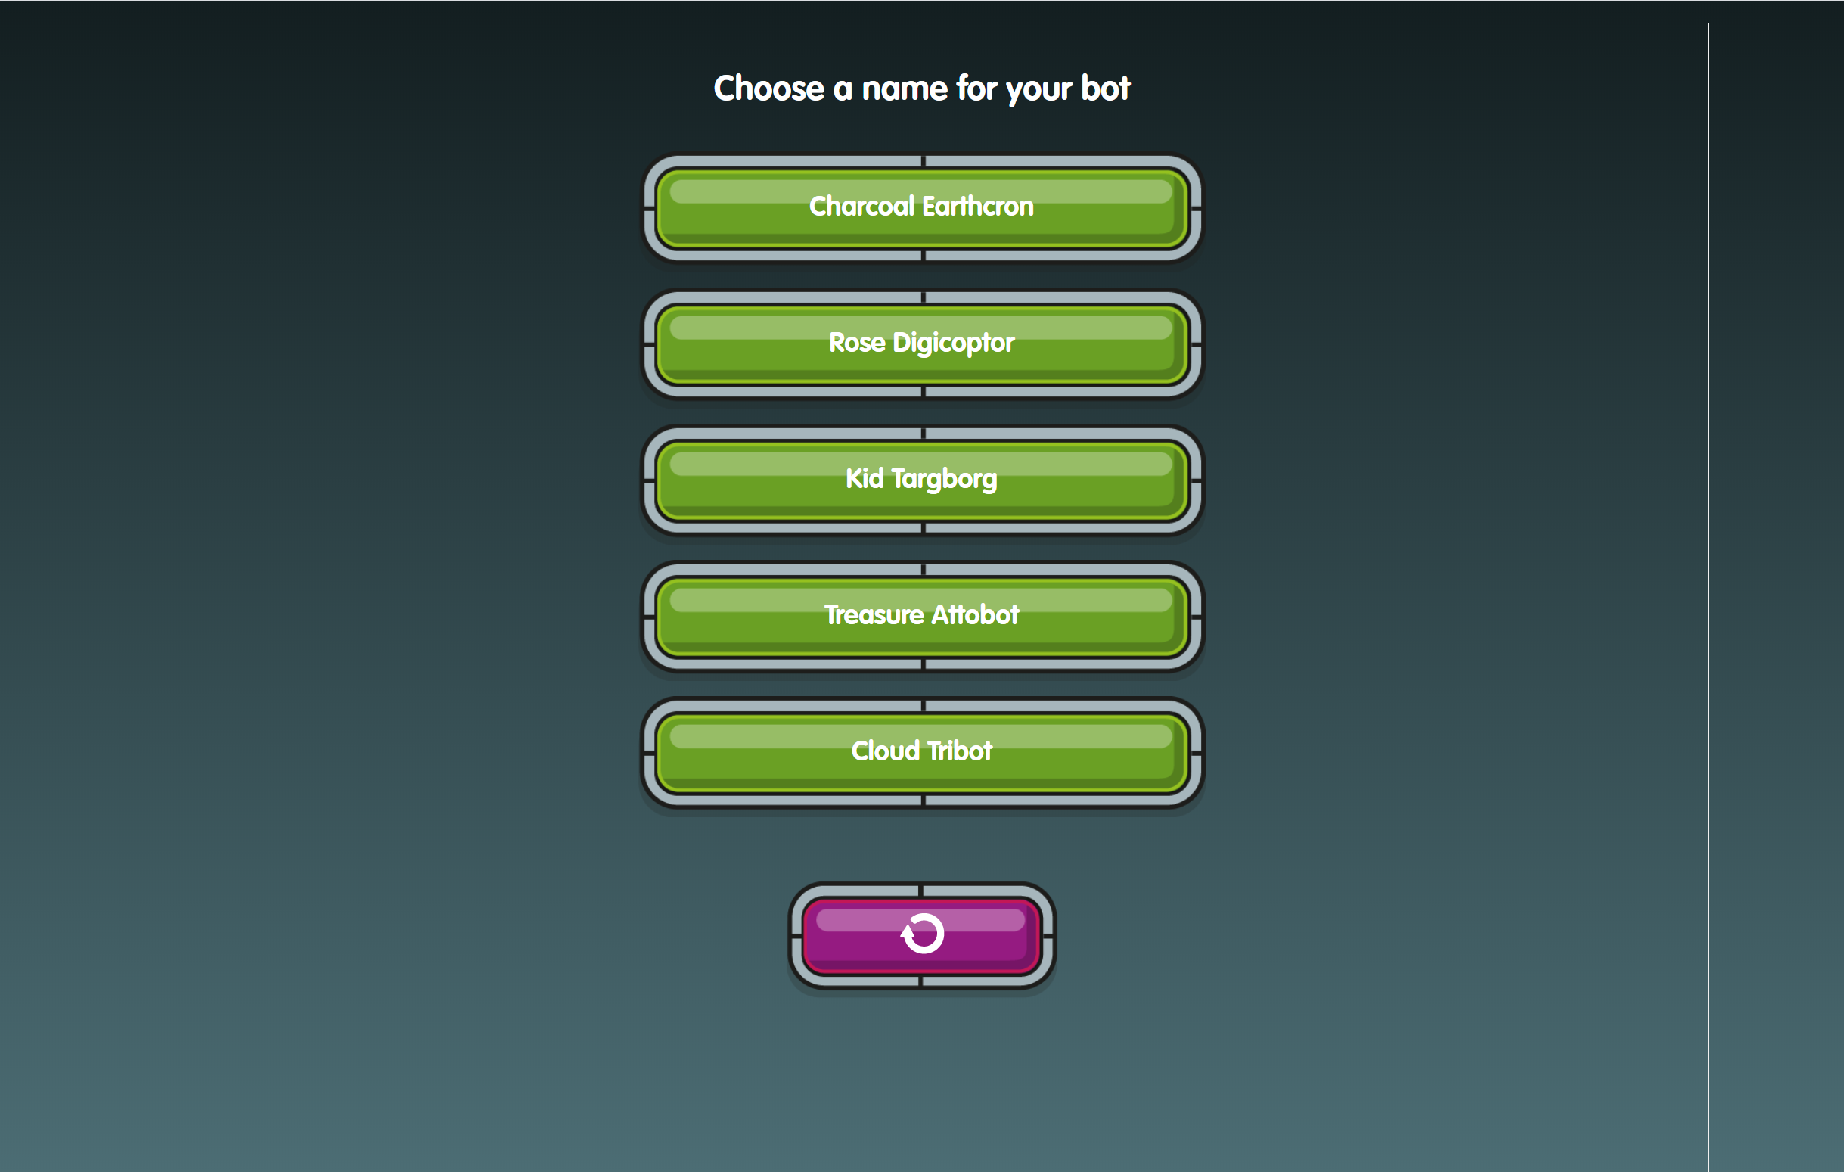
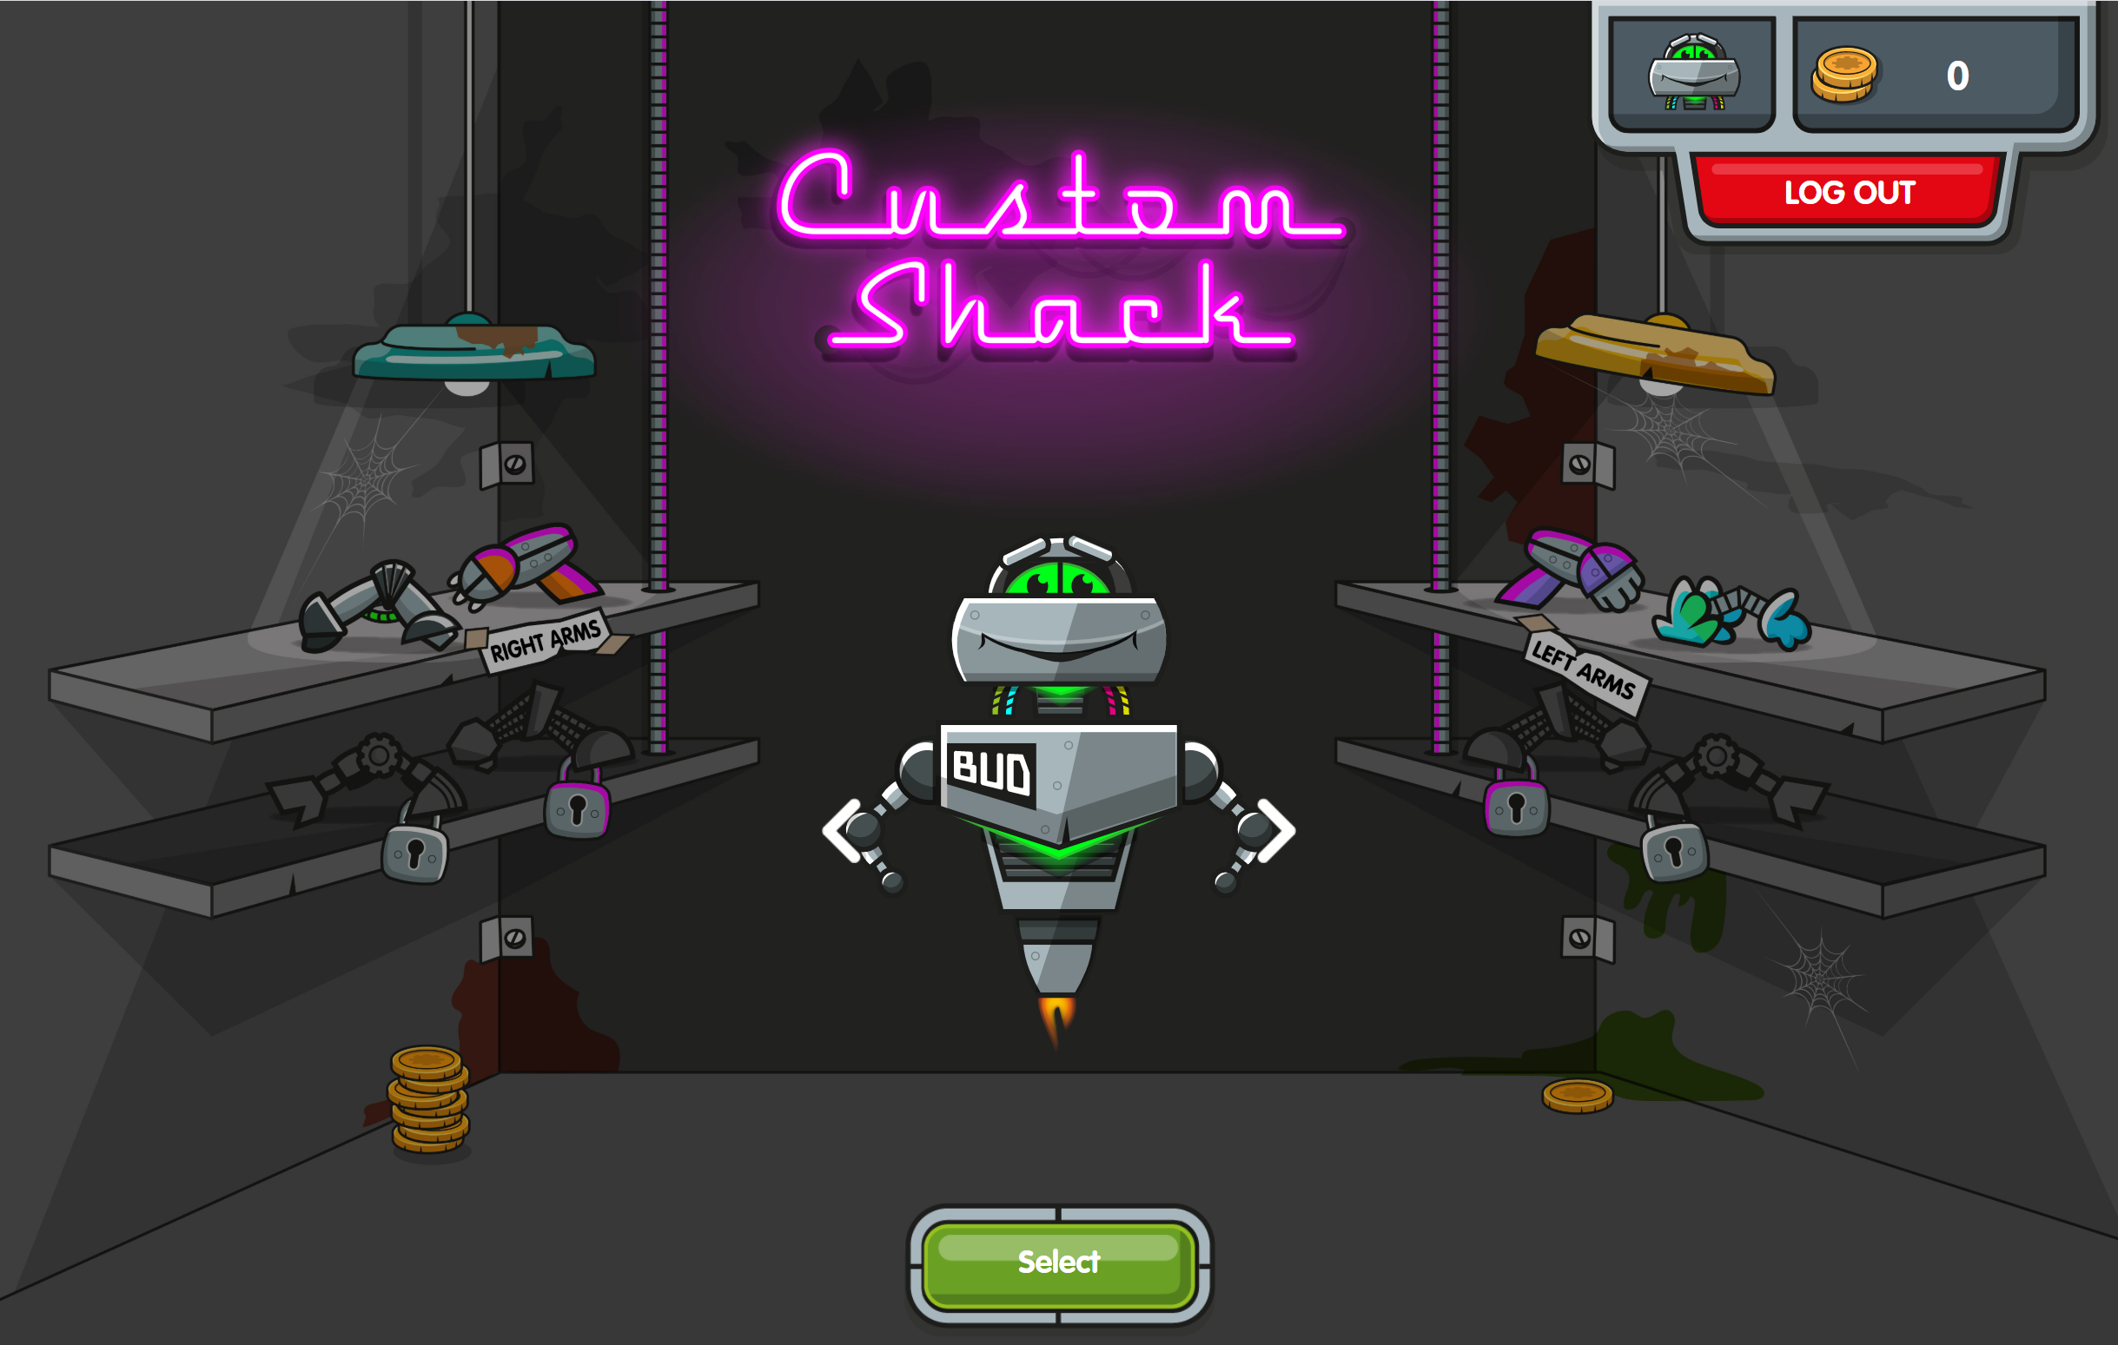
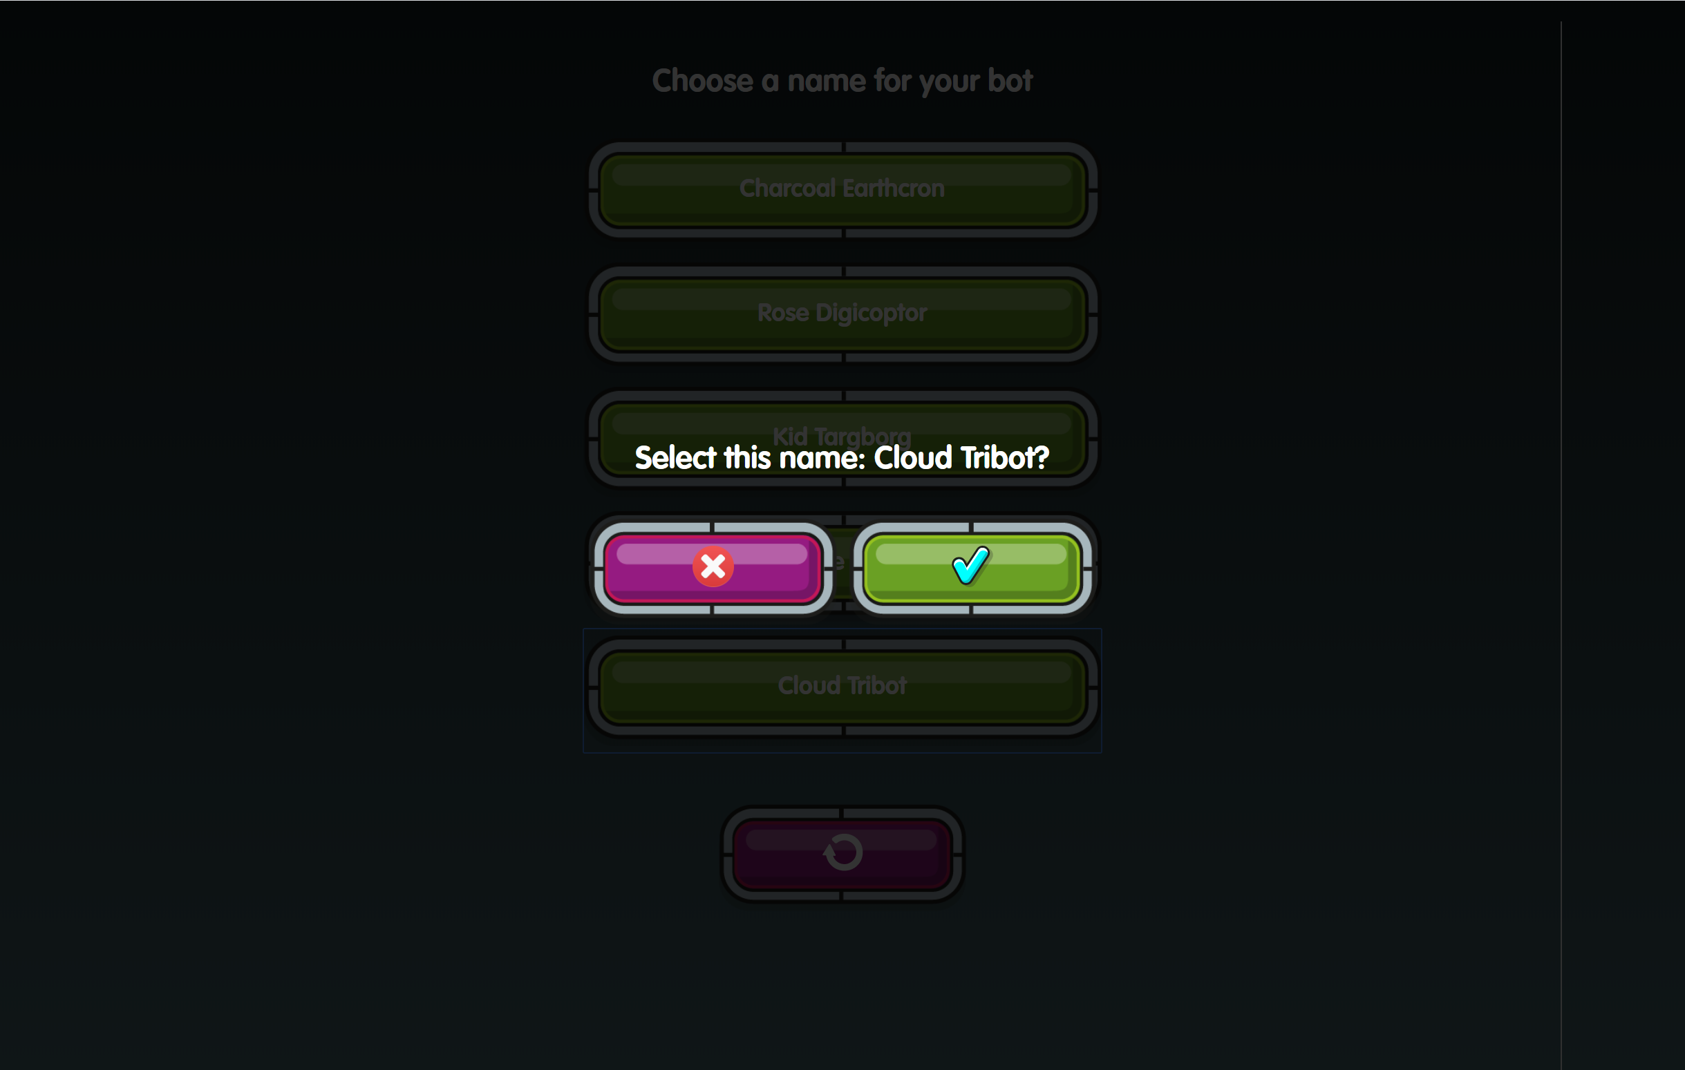
Step 1
Step 2
[Menu]
Choose your Bot!
There are 3 to choose from.
Choose a name for your bot!
Notes:
Log in with your username and password and choose your Bot. Once you have chosen your Bot you cannot go back and change them BUT you can customise once you have earned some coins to spend at the custom shack!

Slide 8
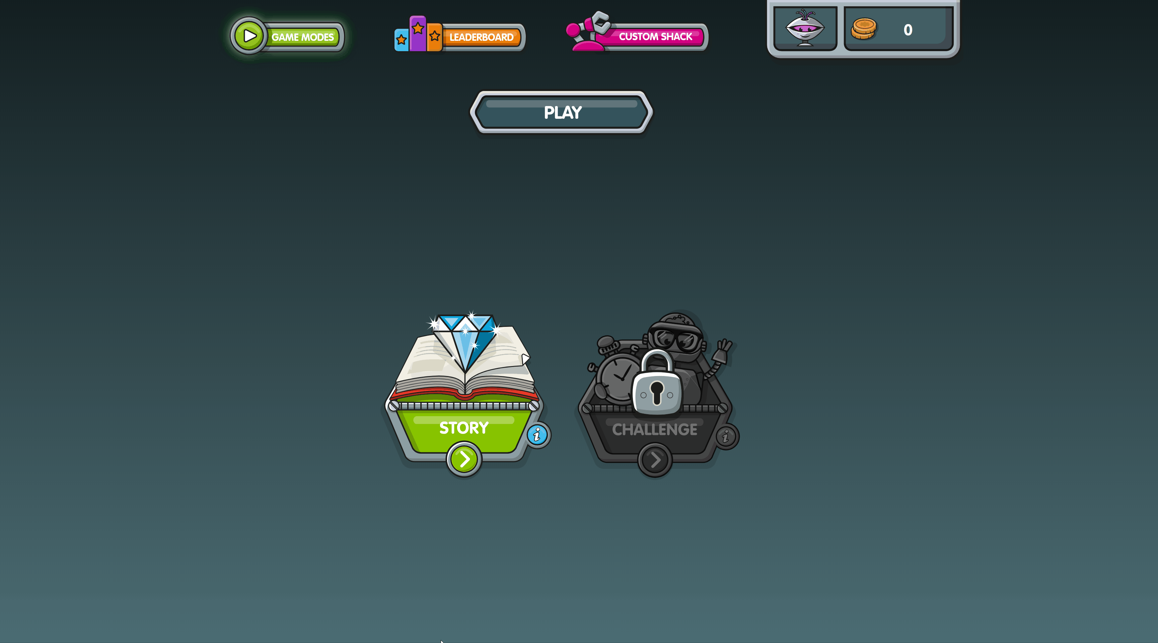
[Menu]
Step 3
Click on Story to begin!
Notes:
Click on Story (or “the green button” if your pupils may struggle to read) then Rust, then level 1.

Slide 9
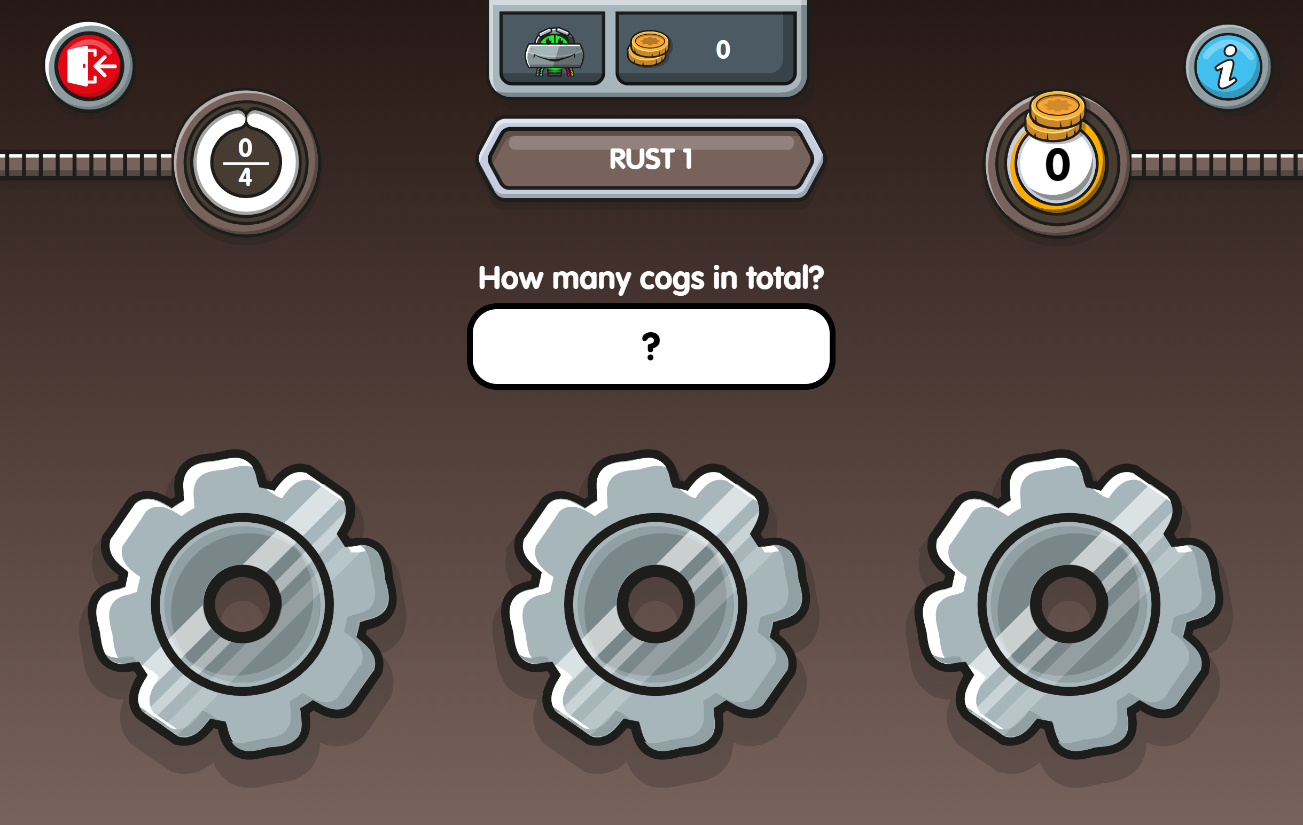
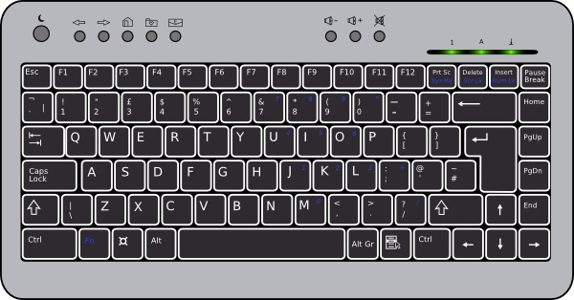
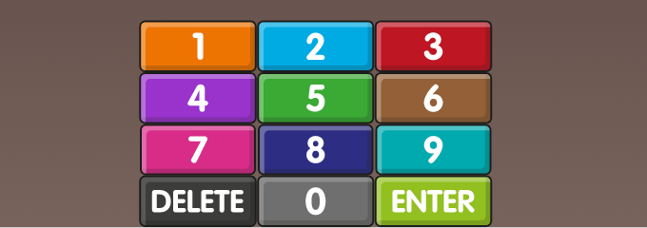
Remember to press ENTER after you type your answer.
[Menu]
Computer
Tablet or mobile
Notes:
Playing Story mode.
Feel free to skip this to save time and get the children playing!
After entering their answer, plays must press the Enter key on the keyboard or onscreen numpad.
The bar flashes green for a correct answer and red bar for an incorrect one.

Slide 10
[Menu]
Important: please don’t allow siblings, friends or family to answer for them but do support your child if they’re stuck.
Little and often In order to get the best out of NumBots children should regularly play for short bursts so we would ask you to give them 5 minutes on Saturdays and 5 minutes on Sundays (or more!)
Game Types 1. Story Mode – the emphasis is on learning the ideas and concepts behind addition and subtraction so it features more diagrams, shapes and question styles. 2. Challenge Mode – the emphasis is more on speed of recall of key facts, like number bonds to 10, doubling small numbers or adding & taking away in your head
100

